Slide 1

YourCodex Mobile App
SENG-3210
Students: Brock Young (T00708314),
Jose Contreras (T00714272).

Slide 2

Agenda
Problem Definition
Design Alternative
Final Solution
Important Areas of Action; Economics, Safety, Environment and Society.
Limitations
Lessons Learned and Future Work.

Slide 3
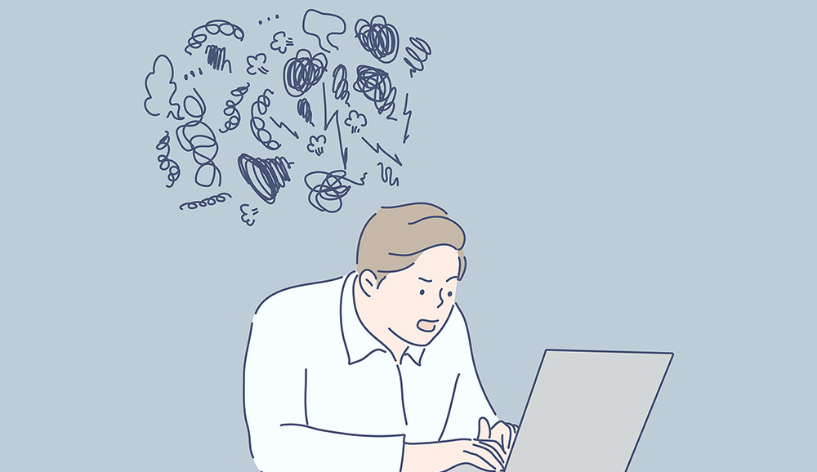
Problem Definition
The current society contains big flows of information across multiple media channels, making users to become tired or to do not find material that they might enjoy.
This situation has become a real problem for users regarding on how they spend their time with such a trivial activity as Reading, therefore, we want to create some product to “filter” this information, being books, and making it more accessible for users

Slide 4

The main idea is to create a book recommender app…..but how?
Our development team came up with three different approaches:
Make a “Simulation” with all the knowledge gathered from the labs.
Use Google Books API with Picasso and Volley tool set.
Use Google Books API with Retrofit client and Glide tool set.

Slide 5
Final Solution
The final solution is the creation of an App where Books and their details are obtained from the Google Books API by using Glide and Retrofit in order to display them into the App Interface.
It combines both the initial idea of the second solution but making it more flexible to developers (use Retrofit instead of Volley) and also focusing the knowledge obtained from the labs into the creation of the actual App User Interface.

Slide 6
Important considerations:
Societal:
The application aims to channel the addictive hold the smartphone has on users and redirect it into books through a similar benevolent matchmaking algorithm.
Environmental:
Key factors are: Minimizing the paper usage per book, minimize green houses from user traffic, minimize storage for books and finally follow good coding practices.
Economics:
The final product was designed completely for free, and minimal external resources. Use of high-quality systems were used to enhance functionality, but only through the free tier to enable a high-quality application for small cost.
Safety:
Key factors such as: User categories for privileges (Admin and normal users), focus into minimum data loss and finally test plans to ensure proper behavior of the system.

Slide 7

Limitations
Unfortunately, YourCodex creation and implementation has some limitations as follows:
Hardware for the development of the Application…
Some initial ideas were not implemented such as Google Login directly.
Limited Firebase Storage

Slide 8
Lessons learned AND Future Work
For the developer team, it was the first time actually applying Agile Method for the development of software.
Android Studio likes to crash….
Creation of UI components takes more time than expected
Recommendation Algorithm is really “simple”.
Admins should be able to actually delete users.

Slide 9
now….YourCODEX’s Demo https://www.youtube.com/watch?v=r-IsVNwIEr0&feature=youtu.be

